Slide 1


DATA MODELLING IN POWER BI

Slide 2
What is Data Modeling? Define data modeling as the structuring and linking of data to create logical relationships, allowing meaningful analysis and insights.

Slide 3

Data Modeling Workflow in Power BI
Step 1: Data Connection: Importing from various sources such as SQL databases, Excel files, SharePoint, and cloud platforms.
Step 2: Data Transformation: Use Power Query Editor for data cleaning, shaping, and transforming before loading into Power BI.
Step 3: Relationship Definition: Establish relationships between tables based on business logic.
Step 4: Model Optimization: Optimize for performance, remove unnecessary columns, choose data types wisely, and manage cardinality effectively.
Visual Aid: Flowchart showing each step from raw data to final model deployment.

Slide 4

Data Sources and Import Methods
Connection Types:
Supported Data Sources:
Import Mode: Stores data locally for high-performance but increases file size.
Direct Query: Accesses live data without storing locally, useful for real-time data but slower performance.
Hybrid (Composite Models): Combining Import and Direct Query in one model.
When to Use Each: Discuss the scenarios in which each connection type is best suited.
SQL Server, MySQL, PostgreSQL, Excel, JSON, OData feeds, SharePoint, Google Analytics, Azure.

Slide 5

Data Transformation with Power Query Editor
Overview: Power Query is an ETL tool within Power BI to shape and clean data before loading it.
Common Transformations:
Filter Rows: Exclude unwanted data (e.g., filter by date, location).
Remove Duplicates: Ensure data uniqueness.
Split Columns: Handle concatenated data values.
Format Changes: Modify data types for compatibility.
Example Transformation: Step-by-step walkthrough for a common transformation, such as merging tables based on a shared key.

Slide 6
Creating and Managing Relationships in Power BI
How to Create Relationships: Demonstrate creating relationships using the Model view or Manage Relationships dialog.
Cardinality:
Importance of Cardinality: Ensures model accuracy.
Options: One-to-Many, Many-to-Many, and One-to-One.
Cross-Filter Direction:
Single vs. Bi-directional filters: Explain the impact of each setting.
When to Use Bi-directional Filters: Only when necessary to avoid performance issues.
Active and Inactive Relationships: Describe scenarios for inactive relationships, such as supporting secondary filters.

Slide 7
Cardinality in Power BI Relationships
Many to One Relationship (*:1)
● Many-to-one relationship is the most common type.
● In this relationship, a column in one table can have multiple instances of a value.
● The related table (lookup table) has only one instance of that value.
One to One Relationship (1:1)
● One-to-one relationship means that each value in a column of one table has a unique match in the related table.
● Both tables have only one instance of a particular value.
One to Many Relationship (1:*)
● One-to-many relationship occurs when each value in a column of one table has a unique match in the related table.
● The related table can have multiple instances of the value from the primary table.
Many to Many Relationship (:)
● Many-to-many relationship is possible in Power BI through composite models.
● It allows establishing relationships where both tables can have multiple instances of values.
● This removes the need for unique values in the tables and previous workarounds.

Slide 8
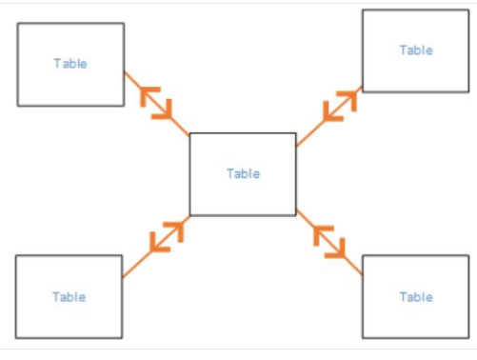
Cross Filter Direction
Cross filter direction determines how filtering choices in connected tables affect the data in Power BI.
● Two options: Both and Single.
Both Cross Filter Direction
● Both setting treats both tables as a single table for filtering purposes.
● Useful in star schema configurations, where a central
table has multiple lookup tables.
● All tables are filtered together as if they were one entity.
Single Cross Filter Direction
Filtering choices in connected tables work on the table where values are being aggregated.
● Data is filtered based on the table where the analysis is being performed.
● Typically used when importing a Power Pivot in Excel 2013 or earlier data model.

Slide 9
Calculated Columns and Measures in Power BI
Calculated Columns:
Used to add new columns based on expressions.
Stored in memory, slower for performance if overused.
Measures:
DAX expressions evaluated on-the-fly during query time.
Memory-efficient, ideal for aggregations and KPIs.
DAX Examples:
Calculated Column: Sales[Discounted Price] = Sales[Price] * (1 - Sales[Discount])
Measure: Total Sales = SUM(Sales[Amount])

Slide 10

Conclusion
Data modeling is a foundational skill in Power BI that transforms raw data into structured, efficient, and insightful formats, enabling users to create impactful visualizations and analyses. By carefully managing data sources, defining clear relationships, and applying optimization techniques, we can build models that enhance performance and scalability. Employing best practices, such as choosing appropriate schemas, minimizing unnecessary complexity, and leveraging DAX measures, ensures that models are both powerful and agile. Ultimately, well-designed data models not only improve data clarity and accessibility but also empower users to drive better, data-informed decisions efficiently.

Slide 11

THANK YOU If you have any questions? thahliyamist@gmail.com
Let’s dive in

